Slide 1


Tracker
CS 293
DEMO
Pratyush Nalam
110050045

Slide 2
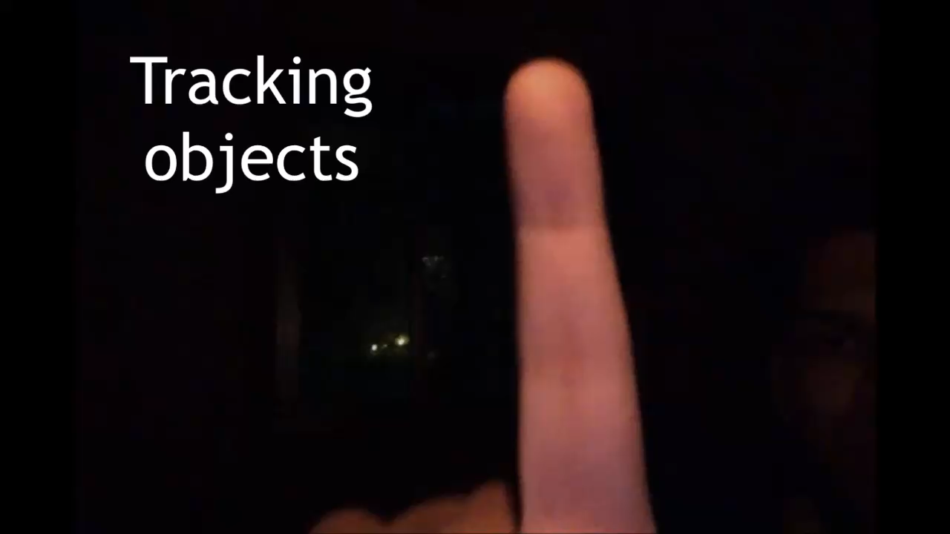

Slide 3
Demo

Slide 4
Acknowledgements
Prof. Varsha Apte
TAs – Ashish and Manasa
Stack Overflow
Google

Slide 5
Highlights
OpenCV
cv::calcOpticalFlowPyrLK
cv::goodFeatureToTrack

Slide 6
Algorithm Design
The question:
How to track moving objects?

Slide 7
The solution:
Convert feed to grayscale
Decide which points to track by reading their RGB values and comparing their positions

Slide 8
Assumptions
Background – preferably dark
Object to be tracked is brighter

Slide 9
Class Design
VideoProcessor
Main class which reads the video, displays the video, retrieves all the properties of the video like codec, frame rate, resolution etc.
FrameProcessor
An interface for all kinds of processing which has to be done frame wise. In the scope of this project, it is used for tracking feature points.

Slide 10
FeatureTracker
Derived from the FrameProcessor class. Converts the frames to grayscale, identifies feature points, decides which ones to track, tracks them and draws lines on the video to show where they have moved. Also gives the direction in which the points have moved – left or right.

Slide 11
Data Structures
Purpose for which the data structure is used | Data Structure used | STL or own implementation
Video Codec | Union | STL
Tracked Features | Vector | STL
Initial positions of tracked points | Vector | STL
Positions of tracked points as they move | Vector | STL
Status of tracked features – success or not? | Vector | STL
If there was an error in tracking | Vector | STL

Slide 12
Source Code
File Name | Description | Author
VideoProcessor.h | Declares VideoProcessor class and methods | Pratyush Nalam
VideoProcessor.cpp | Implements VideoProcessor class methods
FeatureTracker.h | Declares FeatureTracker class and methods
FeatureTracker.cpp | Implements FeatureTracker class methods
Tracker.cpp | Main file which runs the program

Slide 13
Conclusion
Up and down tracking is not accurate, hence not shown. Tweaks required.
Prelude to gesture recognition

Slide 14


Slide 15


